Slide 1
Data Science Capstone
Traffic Collisions

Slide 2
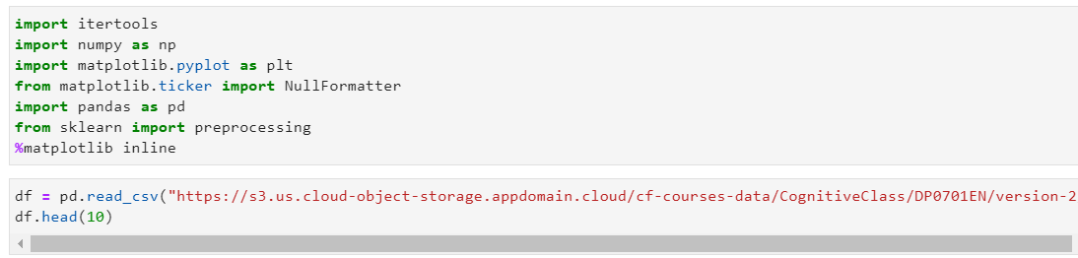
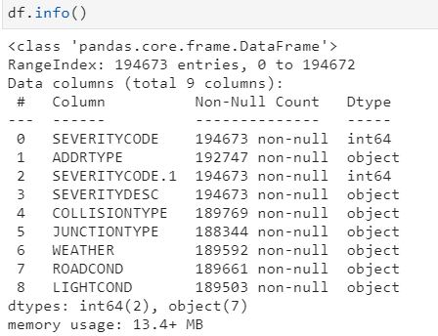
Methodology

Slide 3
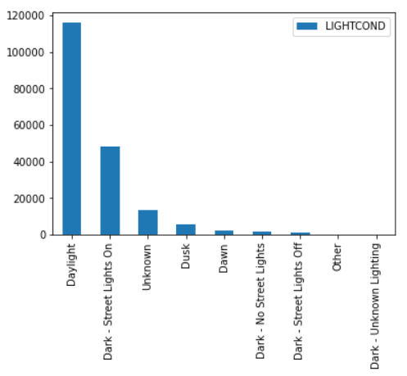
Traffic Collisions VS Light Conditions

Slide 4
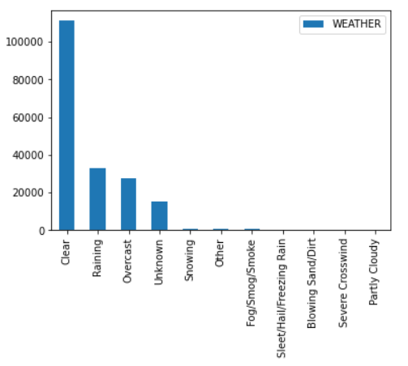
Traffic Collisions VS Weather

Slide 5
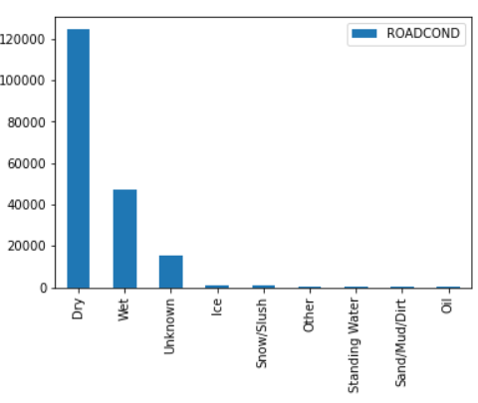
Traffic Collisions VS Road Conditions

